Slide 1
NGP - Updated concept
From ISol

Slide 2
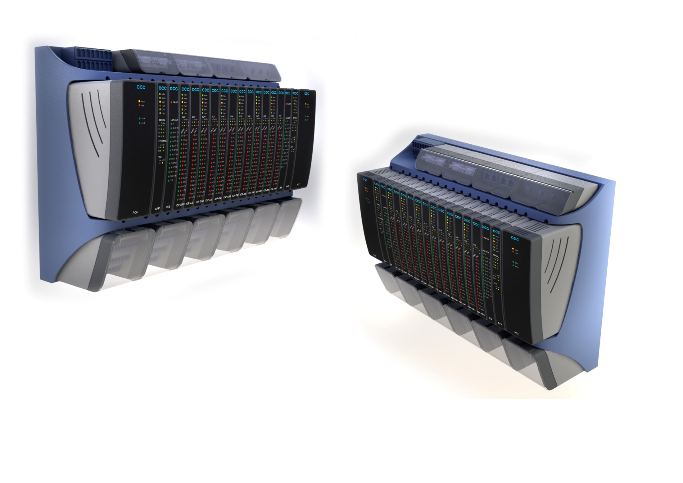

Slide 3
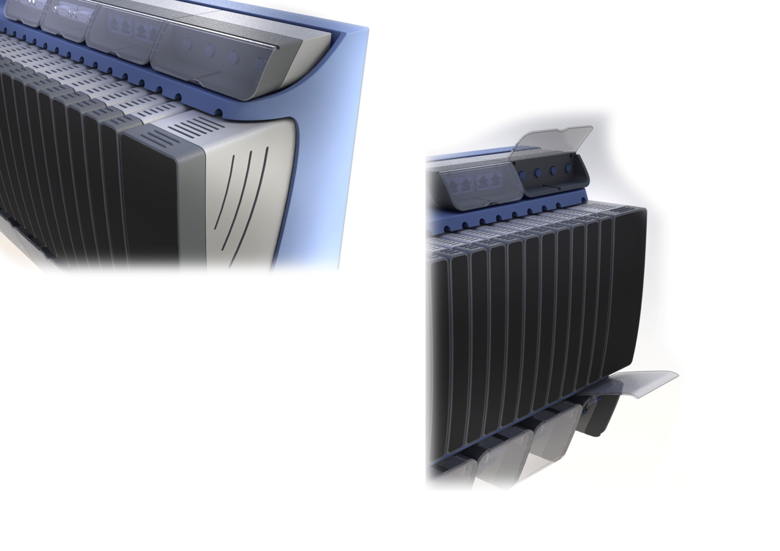

Slide 4
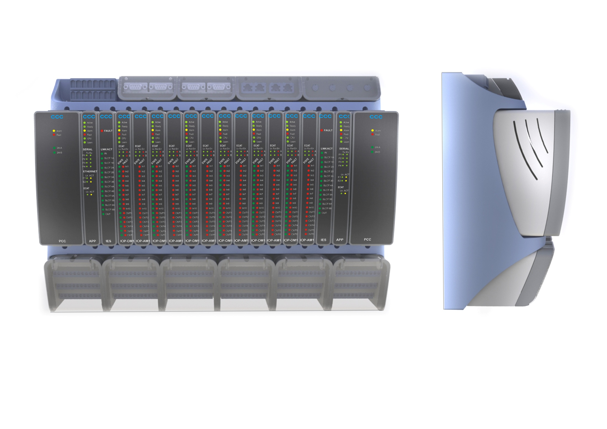

Slide 5
